Slide 1
Cyberbullying
Suzy Ries

Slide 2
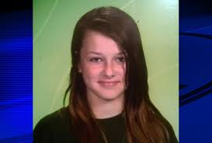
Introduction
Story of Rebecca Sedwick
Personal Introduction
Why I picked this topic
The goal of my talk

Slide 3
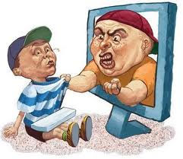
What is cyberbullying?
Definition
Not a one time occurrence
Effects

Slide 4
8 Facts about cyberbullying
Occurs mostly in females
A problem for over 3 million Americans
Usually starts from 10-16 years of age

Slide 5
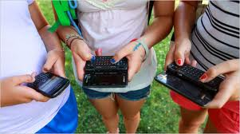
Why kids cyberbully
Revenge
Entertainment
Power hungry
Mean girls

Slide 6
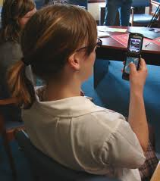
Types of cyberbullying
Direct attacks
Cyberbullying by proxy

Slide 7
Cyberbullying by Proxy
Instant messaging
Stealing passwords
Blogs
Websites
Pictures
Gaming

Slide 8
How to prevent cyberbullying
Teach consequences
Talk about respecting others
What parents can do
Take 5

Slide 9
Summary and conclusion
Remember we each have to do our part to stop cyberbullying

Slide 10
Thanks for listening
Are there any questions?

